Slide 1

Module Six
Work Group Dynamics
& Problem Solving

Slide 2
What is a “Group within the Organization
A work Group is defined as two or more employees who
  Interact with each other.
  Perceive themselves as sharing several common interests or goals
  Come together or are brought together to accomplish a meaningful organizational activity

Slide 3
Understanding Group Work Dynamics
What are the types of groups in organizations?
  Formal groups.
  Informal groups
  Project teams

Slide 4
Understanding Group Work Dynamics
What are the types of groups in organizations?
  Formal groups’ criteria.
    Two or more members
    Prescribed interaction pattern
    Purpose (s) stated in a meaningful organizational terms
    Members who are aware of the formal group’s existence in their involvement in it.

Slide 5
Understanding Group Work Dynamics
What are the types of groups in organizations?
  Formal groups sub-classification:
    Task group: works together on a series of related activities e.g. self-directed team e.g. a team assembles car emission system.
    Command group: exercises authority within the organization e.g. board of directors for any public corporation. Members of the board of directors are grouped into sub-committees to oversee particular company function while each board member is responsible for representing shareholders interests.

Slide 6
Understanding Group Work Dynamics
What are the types of groups in organizations?
  Informal groups
    It is a a group of employees who come together voluntarily for a common purpose.
    Managers do NOT always encourage informal groups. (they may develop goals which are not consistent with the organizational goals). Informal groups may even threaten management with public exposure of wrong practices within the organization. This might lead to polarization
    Informal groups can function as “whistle blowers” about corrupted organizational work systems

Slide 7
Understanding Group Work Dynamics
What are the types of groups in organizations?
  Project Teams
    Project teams are used to generate solutions for important organizational problems.
    Characteristics of Project teams:
      The life span is kept short (usually less than 4 months)
      Membership is always voluntary
      Support staff is not assigned to the project team to prevent it from becoming ossified in bureaucratic procedures.

Slide 8
Understanding Group Work Dynamics
What are the types of groups in organizations?
  Project Teams
    Project teams are used to generate solutions for important organizational problems.
    Characteristics of Project teams:
      Project team is pulled together quickly without formal selection process
      Communication and project documentation are informal because the project team’s focus is not allowed to shift from problem characteristics to the team’s organizational.

Slide 9

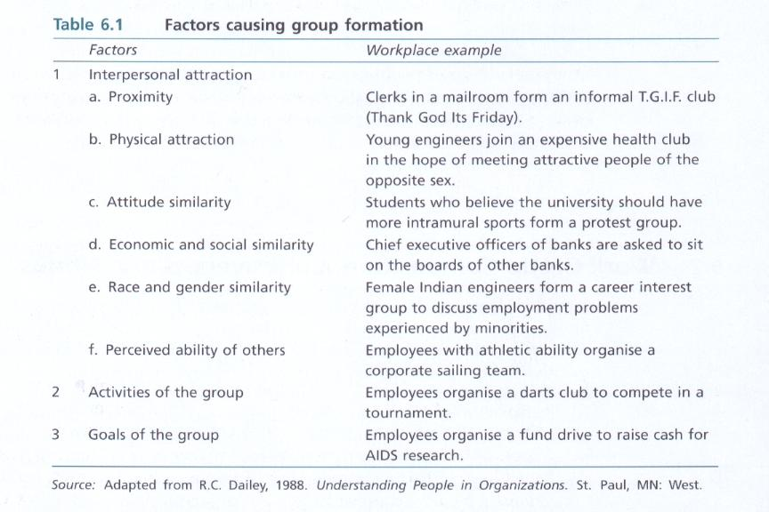
Why Individuals Are Attracted to Groups?

Slide 10
High Performing Teams
Three conditions influence work groups performance in areas valued by the organization
  The level of work group cohesiveness
  The performance goals set by the group
  The degree of agreement between group performance goals and organizational performance goals.

Slide 11
WORK GROUP NORMS
Work groups have norms for controlling members’ behaviour.
Norms are the group’s standards for members’ behaviour.
Norms exist in any work group and exhibit several common properties.

Slide 12
WORK GROUP NORMS
Work groups have norms for controlling members’ behaviour.
  Norms summarize the influence process.
  Norms apply to member behaviour and not to their thoughts.
  Norms develop for those behaviours which influence levels of member effort and group goals.
  Norms develop over time and they are resistant to change.
  Some members have more right to deviate from work group norms than other members do.

Slide 13
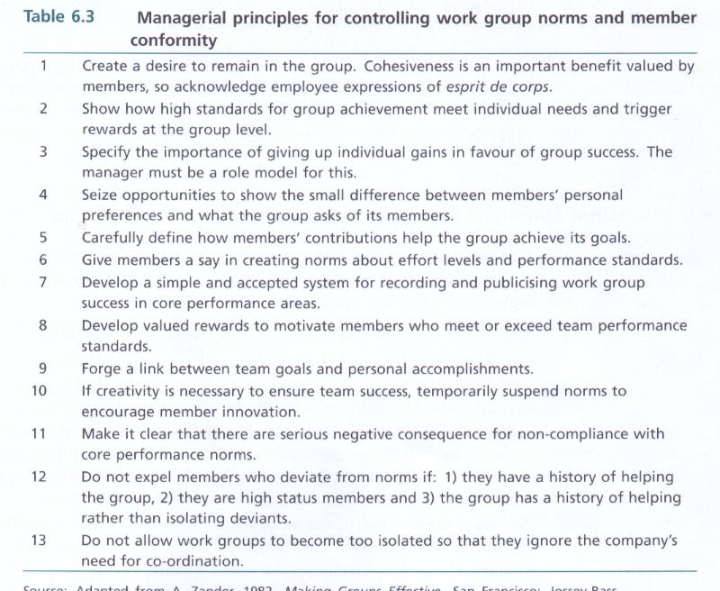

Slide 14
GROUPTHINK DEFINED
If cohesiveness is extremely high, members of the work group voluntarily adapt their behaviours to the group’s norms.
If a work group’s critical thinking process is suspended because of high cohesiveness and conformity, groupthink is present.
When groupthink is present, members are more concerned with the solidarity and fellowship than with the quality of the decision.

Slide 15
GROUPTHINK SYMPTOMS/ INDICATORS
Collective rationalization: The group believes it can not fail because members are oblivious (unaware) of indicators which could spell troubles.
The illusion of invulnerability: success can be achieved easily even in the face of unfavorable chances.
Mindguards: Much like celebrities who have bodyguards, groups have self-appointed guards who eliminate unwanted negative uncomfortable external information.

Slide 16
GROUPTHINK SYMPTOMS
Belief in the inherent morality of the groups: our decisions are moral and justified on morality “alone”
Direct pressure applied to dissenters (nonconformist): Mind guards bring nonconformist back in line.
Self-censorship: Group members opt for silence in case of doubt, rather rock the boat by expressing unpopular idea.
Negative stereotyping of opposition : stupid, cowardly
Illusion of unanimity (agreement): Each member mistakes the silence of others as their agreement.

Slide 17
Groupthink Control
The leader must assign the role of critical evaluator to members on a rotating basis. He must allow his position in group decisions to be criticised.
Influential members should not pre specify solutions or methods for reaching solutions.
Idea generation should be separated from idea evaluation.
Subgroups arrive at their own decisions separately before polling the entire group on its decision.

Slide 18
Groupthink Control
At intervals, outside experts might provide guidance to the group.
When competitive organisations are the focus of group decision making, sessions should be devoted to exploration of warning signals and forms of retaliation.
A ‘second chance’ meeting should be held after the group has selected its official position or made its decision.
Groupthink is often caused by leaders who are simultaneously autocratic and charismatic.

Slide 19
Work Group Structure
Group structure and is defined as the arrangement of roles or positions within the group.
As group size increases, the opportunity for Face to face contact and the duration of the contact both decrease.
The time for member participation decreases as work group size increases.

Slide 20
Group size and internal conflict
As work group size increases, members
often exhibit :
1) less agreement
2) more dislike for each other
3) less tension
4) greater release of tension.

Slide 21
TEAM WORK
What is the most important determinant of
team performance?
The Team leader (facilitator)
A specific performance challenge (goal) that is clear and compelling to all team members is the greatest motivator

Slide 22
Group Size & Performance
What is the ideal size range of teams?
The ideal size seems to be no more than 10-12 members
A research done by DuPont indicates that serious
deterioration in the quality and productivity of team interactions begins to set when there are more than 10-12 members of the team.

Slide 23
Performance & Process Losses
Potential performance is defined as
The level of performance which could be achieved under ideal conditions as a result of the combined skills, abilities and experiences of work group members
.
Process losses: are any obstacles to achieving potential performance for the group.
Examples: groupthink, membership turn over, and interpersonal conflict

Slide 24
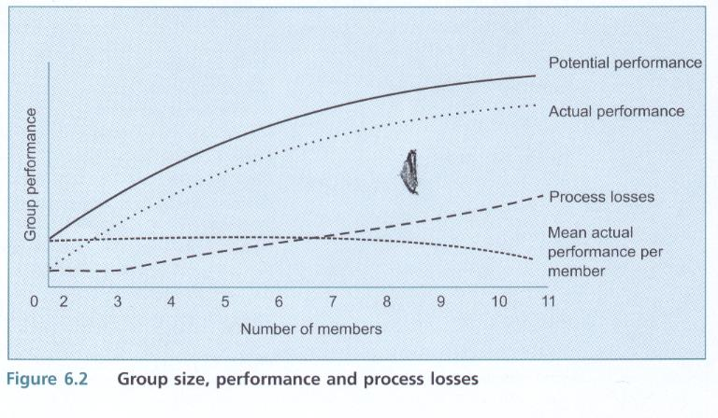

Slide 25
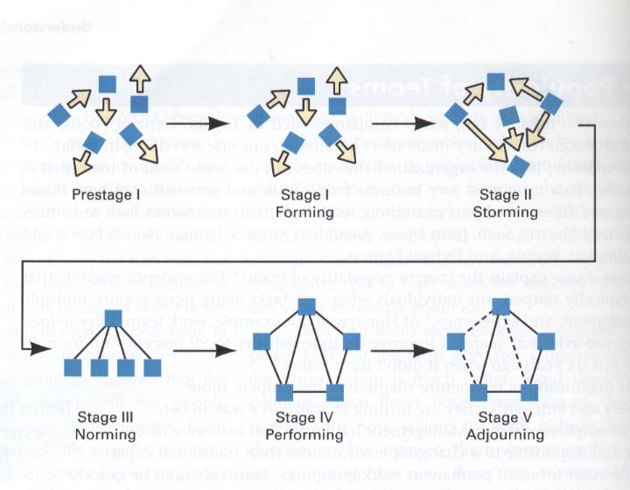
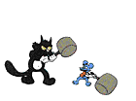





STAGES OF Work Group Development

Slide 26
STAGES OF Work Group Development
Stage 1: Test and Orientation
Composition of the group
Soothing entry into the group for all members
Creating purpose and sense of urgency

Slide 27
STAGES OF Work Group Development
Stage 2: Conflict and Organization
Developing rules for handling conflict
Filling the leadership position

Slide 28
STAGES OF Work Group Development
Stage 3: Cohesion and Information Exchange
Interpersonal conflict subsides
Members become thoroughly aware of their involvement and commitment
Preventing group thinking
Sustain task focus
Strong feeling of solidarity

Slide 29
STAGES OF Work Group Development
Stage 4: Interdependence and problem Solving
Shifting from potential performance to actual performance.
Willingness to confront conflict (personal & task-related)
Acceptance of authority/ Active participation
Stage of group maturity
Ability to detect process losses in good time
Maintaining norms as membership changes

Slide 30
STAGES OF Work Group Ddvelopment

Slide 31
Work Groups and Stage 4, Performing
Turnover, changes in goals, new technologies, rising competition and changes in leadership, all push work groups out of stage 4.
* Part of a mature group’s resources must be devoted to:
- Socialising and training new members
- Changing ineffective norms
- Creating new positions requiring new behaviours
- Scanning the external environment for changes -
which threaten to expel the work group from stage 4

Slide 32
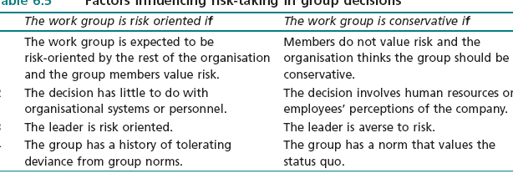
Factors influencing
Risk-Taking in Group Decisions

Slide 33
Creativity & Brainstorming
The fundamental principle of is the separation of idea generation from idea evaluation.
It is called the principle of deferred judgement
The group can generate many possible solutions, effects and outcomes without becoming trapped in criticising suggestions.

Slide 34
Brainstorming Rules
(a) Break down complex problems into smaller problems.
(b) Any idea can be proposed by any member at any time.
(c) Ideas must be generated quickly .
(e) Criticisms or evaluations are not allowed .
(f) Lengthy discussions are to be postponed.
(g) The more suggestions the better.
(h) The session runs until no more ideas .
(i) Idea evaluation is separate from idea generation.

Slide 35
Factors which contribute to low-Group Creativity
1 The group has no common goal or core focus.
2 No standard method for making decisions is followed.
3 The process of generating ideas is not separated from the evaluation of ideas.
4 Ideas are not evaluated on their own merits.
5 Ideas do not become the property of the group once they are suggested.
6 Conclusions are an individual product instead of a group product.

Slide 36
Factors which contribute to low-group creativity
8 Some members do not feel sufficiently at ease to participate and submit their ideas.
9 Some members dominate or deflect the group from its stated purposes.
10 The group does not have access to higher management.
11 The group places pressure on its members to make their behaviour conform to a low standard for creativity.
12 The group is critical of failures and blames members for failures.

Slide 37
Group Creativity, Nominal Group Technique “NGT”
1- The question under study is posted in front of the group who members silently generate ideas in writing without looking at the work of others or discussing the question.
2- The leader goes around the table and asks each participant to read one idea from his/ her notes. These ideas are recorded in some way (flip chart, computer)
3- All participants present their ideas for recording until all are shown.

Slide 38
Nominal Group Technique “NGT”
Each member record the ideas on cards and rank orders them secretly from 1 to “n”. The mean average rankings are used as a basis for the group’s decision. The NGT process can end here or the decision may be refined through discussion and rewording.
The voting patterns can be analyzed to see if more accurate decision be made.
A final vote is taken.

Slide 39
NGT versus Brain Storming
The NGT has advantages ove common Problem solving methods.
1- idea generation is separated from idea evaluation.
2- balanced participation occurs and the effects of dominant individuals
on group decision making are lessened.
3- it ensures the systematic movement towards the aggregation of votes to determine a preferred outcome.
4- a group in any stage of development can use the NGT.
5- It is time efficient and members find the process to be satisfying.
On the negative side:
  the NGT is highly formalised and
  its repeated use can lead to member perceptions of ‘ritualistic decision making’.

Slide 40
DELPHI TECHNIQUE
Used when members can not attend a meeting.
It is a method for gathering systematically written judgments from members using a set of questionnaire.
Members of the group may not know the other group members
It needs central coordinating mechanisms to manage the alteration, transmission and summarizing the questionnaire data.

Slide 41
Are Delphi Groups Effective?
Evidence indicates that Delphi groups can be more effective.
The average performance was higher for Delphi groups than for undisciplined groups both working on a comparable problem solving task.
Delphi groups eliminate the effects of dominant personalities on group decision making and the effects of perceived member status on group decision making.
E. mail systems and the World Wide Web create obvious advantages to the use of Delphi groups.
Delphi groups are quite different from nominal groups.

Slide 42
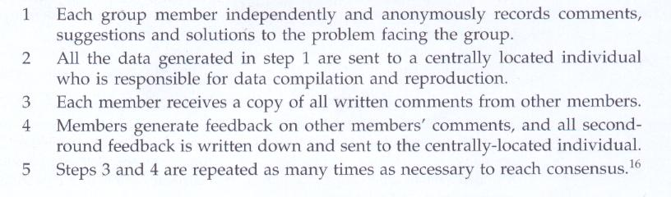
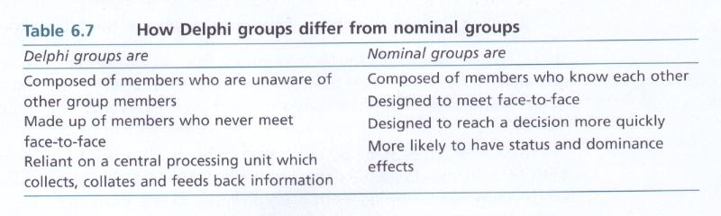
DELPHI TECHNIQUE

Slide 43
Guidelines for Managing Groups
Managers must shift their emphasis between the two tasks which influence the effectiveness of group decision making.
Task activities are defined as those group activities which channel member efforts to achieve the purposes of the group, such as
  Work methods definition, plan schedules or assess service or product quality.
Maintenance activities are group functions which nurture and sustain the emotional qualities in a task group such as
  member satisfaction, wellbeing and the group’s cohesiveness.

Slide 44

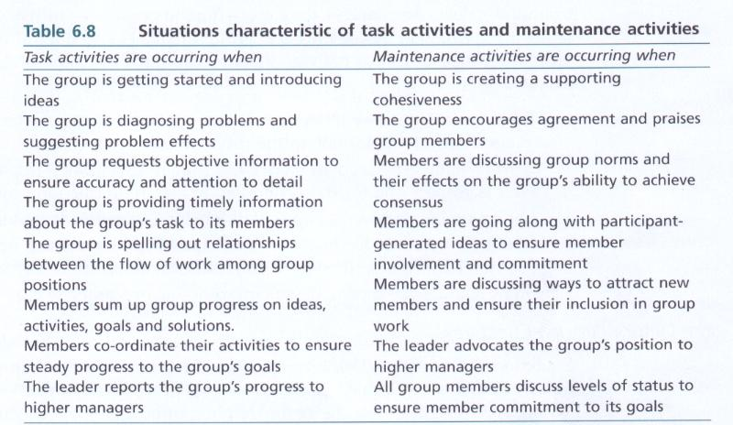

Task Vs. Maintenance Activities

Slide 45
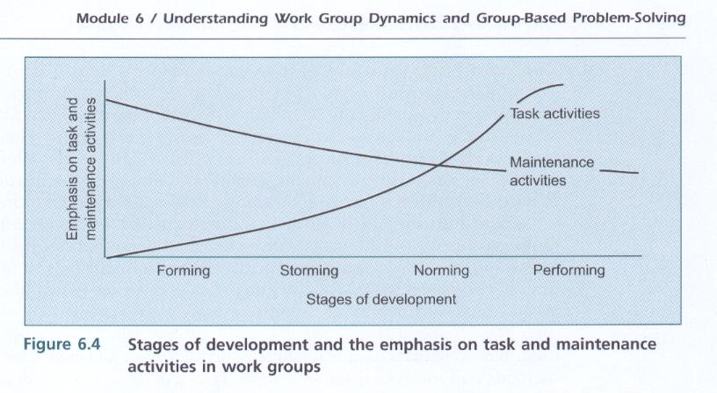
Task Vs. Maintenance Activities

Slide 46
Guidelines to Minimise
The Process Losses
1 Define the work group’s task or problem carefully.
2 Do not jump to idea evaluation before idea generation has created numerous alternatives.
  This is a process loss which can be avoided by using brainstorming
3 Avoid groupthink .
  teach all group members how to recognise the symptoms of groupthink.
4 Manage the norms of the group by making valued rewards contingent on high quality group performance.
5 Make group level rewards contingent on the group’s contribution to work unit successes.

Slide 47
Laggards in Groups
(Social Loafing)
Members who do not perform their fair share of the group’s work.
They are practitioners of the fine art of social loafing because they cause average member effort and performance to decline as group size increases.
Explanations for social loafing:
1) Equity of effort
2) Loss of personal responsibility (‘It’s a large group, no one will miss me)
3) Reduced effort caused by reward sharing (‘Everyone is paid the same, so why should I put in extra hours?’
4) Coordination complexity in larger groups

Slide 48
Reduction of
Social Loafing in Groups
1 Focus on the interesting and important aspects of the task.
2 Assure members that their contributions are identifiable .
3 Tell group members that they should not tolerate inadequate effort or performance from group members.
4 They should expect to have their performance evaluated.
5 Ensure that some portion of rewards received by group members is dependent on their performance.

Slide 49
Decision-Making in Teams
The forms of decision making
The AI form. A manager makes a decision alone, using the information
currently available. boss centred style of decision making.
The AII form. A manager seeks information from subordinates or group
members and then makes a decision. Employees may or may not be aware of the problem before the manager takes a decision.
The CI form. A manager explains the problem to his subordinates in a one to one format. The manager takes a decision which may or may not reflect the ideas of his subordinates.
The CII form. A manager explains the problem at hand to his subordinates in a group format. The manager takes a decision which may or may not reflect the ideas of his subordinates.
The GII form. A manager explains the problem to his subordinates in a group format. With the manager, the group makes a final decision.

Slide 50
The Vroom -Normative
Decision Model, Decision tree
The key to using the normative model is the manager to match the correct decision making style with the characteristics of the situation using the decision tree by answering a series of structured questions about the decision situation.
The critical attributes of the questions are:
  The available time to make the decision
  The importance of quality in the decision
  The importance of subordinate commitment to the decision
  The extent of information available to make the decision.

Slide 51
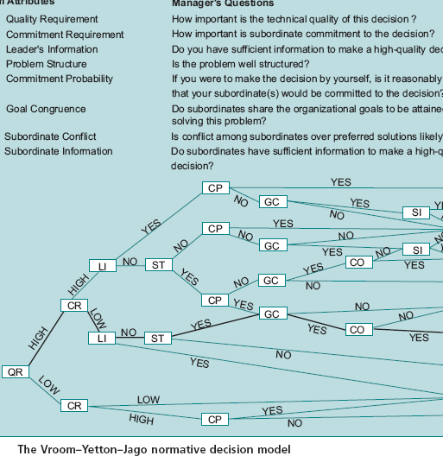
The Vroom -Normative
Decision Model, Decision tree

Slide 52
Resolving Conflict
10
Win/Lose
Win-Win
5
Compromise
Degree of satisfaction of Party A’s Interests
0
Lose/Lose
Lose/Win
0
5
10
Degree of satisfaction of Party B’s Interests

Slide 53
Resolving Conflict in Teams
Collaboration
(Problem solving)
10
Forcing
5
Compromise
Degree of satisfaction of Interests
0
Avoidance
Accommodation
0
5
10
Degree of satisfaction of Relationship

Slide 54
Resolving Conflict
Avoiding should be adopted as a strategy when:
  The issue is trivial
  No chance to satisfy concern
  Costs of conflict outweigh the benefits of resolution
  When it is necessary for people to calm down and gain perspective
  When gathering information is more important than immediate action

Slide 55
Resolving Conflict
Accommodating Strategy
  It is self-sacrifice strategy
  If you fear losing the relationship
  When you realize that “winning this battle means losing the war”.
  A manager decides he is wrong
  An issue is more important to others than it is to the decision maker.
  Potential public damage created by a conflict
  Employee development can be achieved by letting subordinate learn from their mistakes.

Slide 56
Resolving Conflict
Forcing Strategy
  It is using power or pressure to impose solution
  Examples : emergency conditions: during nuclear reactor dangers , chemical fires, environmental disasters which leave no room for discussion
  Unpopular action

Slide 57
Resolving Conflict
Compromising Strategy
  It is equal power of involved parties in the dispute and fixed amount of resources must be divided in some way.
  When you are not ready to lose the relationship and the interest.
  It could be used as a temporary solution
  It could be used as a back up when collaboration is unsuccessful

Slide 58
Resolving Conflict
Collaboration Strategy
It is the problem solving approach where the needs of parties are integrated to solve the problem.
  Steps:
  Recognize and define the problem
  State the problem in specific terms before searching for solutions
  Conduct non judgmental discussion of the facts & the problem
  Develop criteria for measuring the quality and practicality of the proposed solution
  Develop alternatives leading to best solution
  Select the best alternative tentatively till agreed

